Slide 1
Simulation of the model
By Billy, 11.29

Slide 2
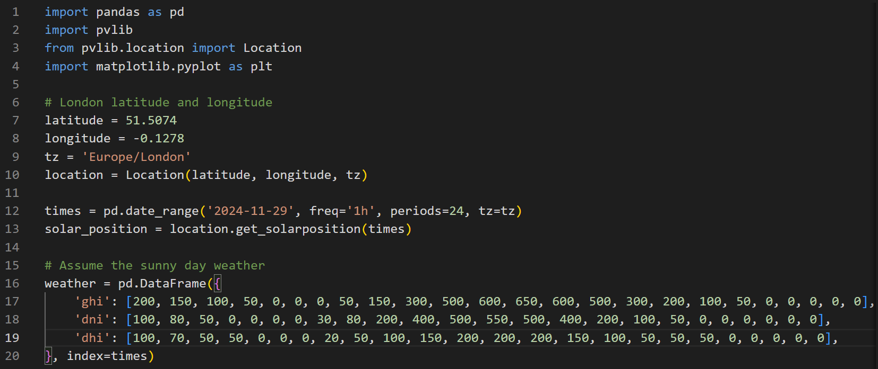

Slide 3
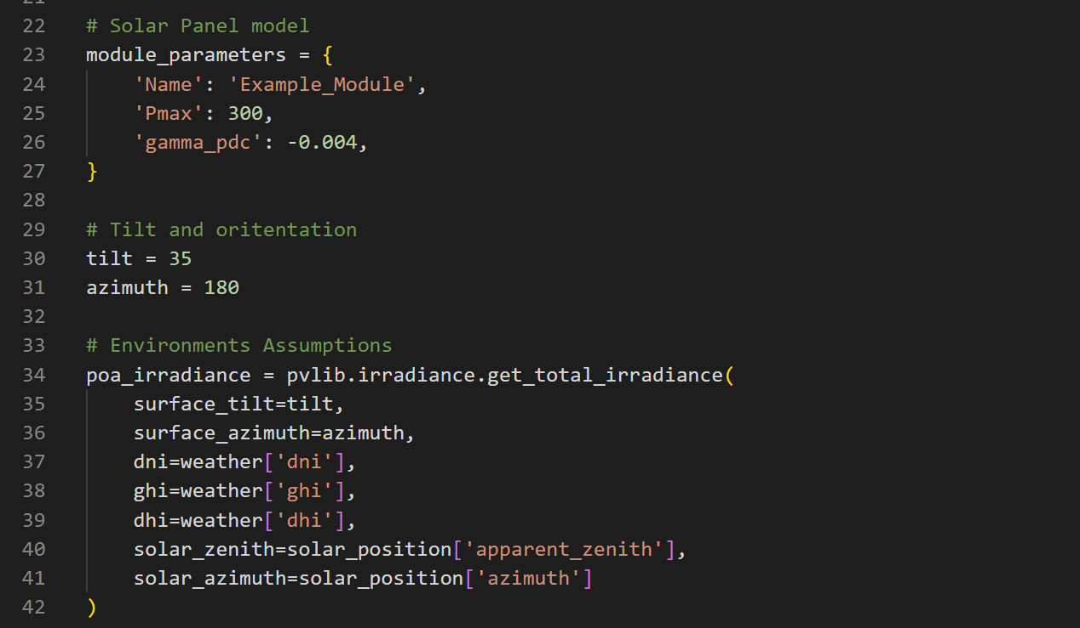

Slide 4
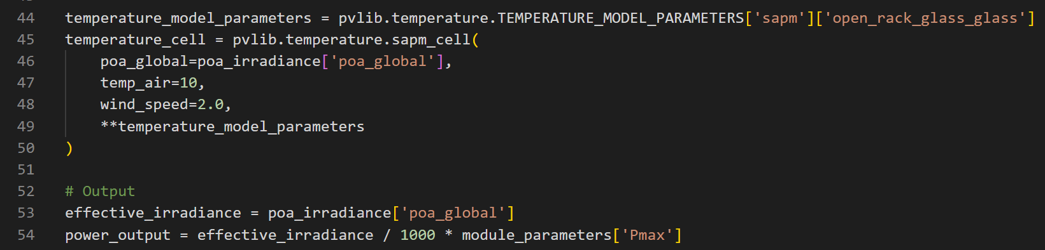

Slide 5
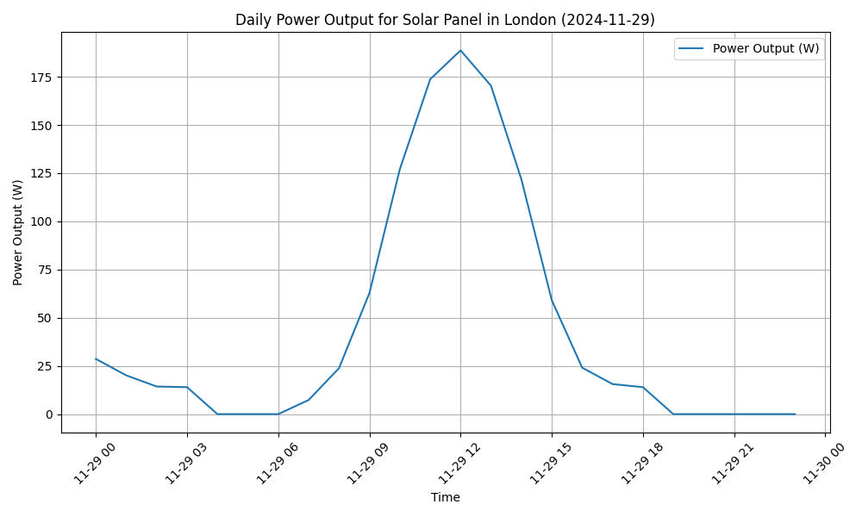

Slide 6
Machine learning methods
By Van, 11.29

Slide 7
Supervised Machine Learning
Construct the potential features, e.g. peaks ,means and difference.
Feature selection and Choose models,
pending on the Interpretability and Accuracy.
Use some test methods to show the accuracy of obtained models ,e.g. MSE and confusion matrix.
Some other resampling methods and linear model selections.
The trained model is the final model.

Slide 8
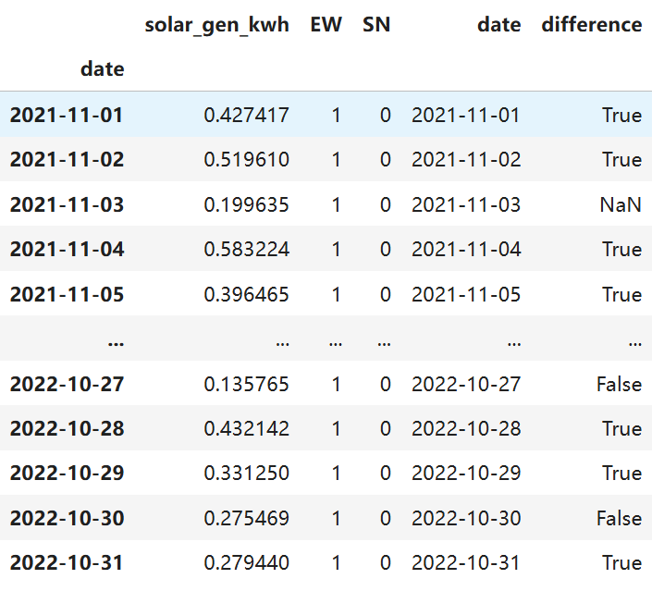
Feature and modification of response

Slide 9
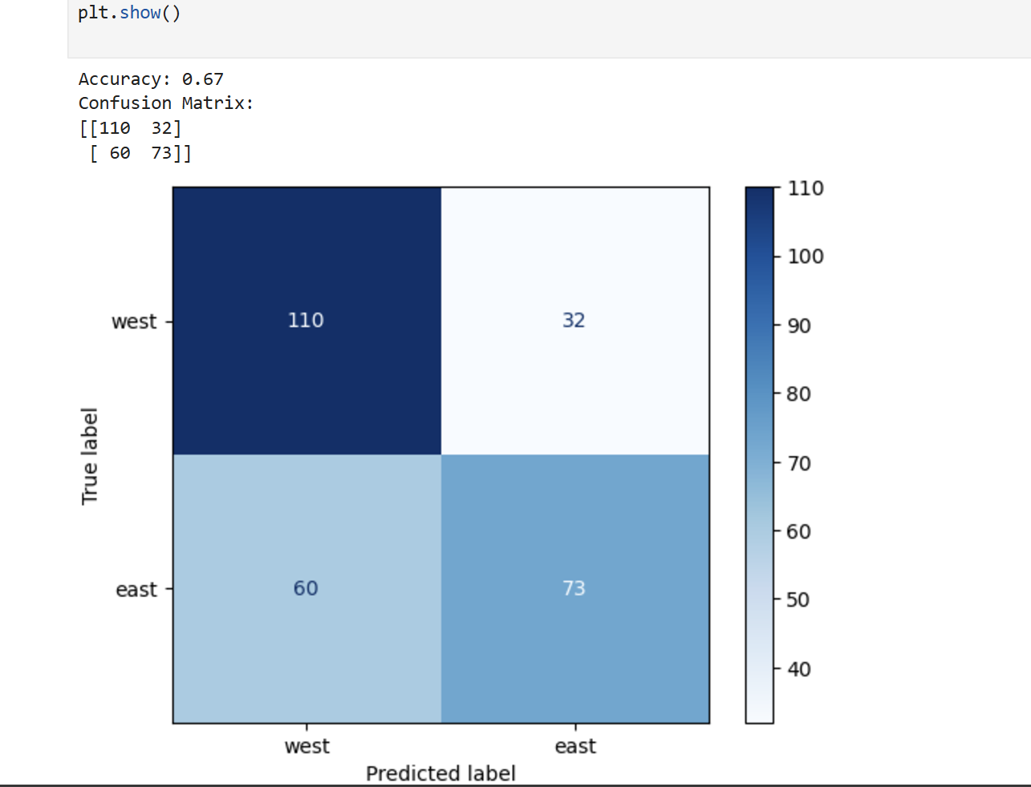
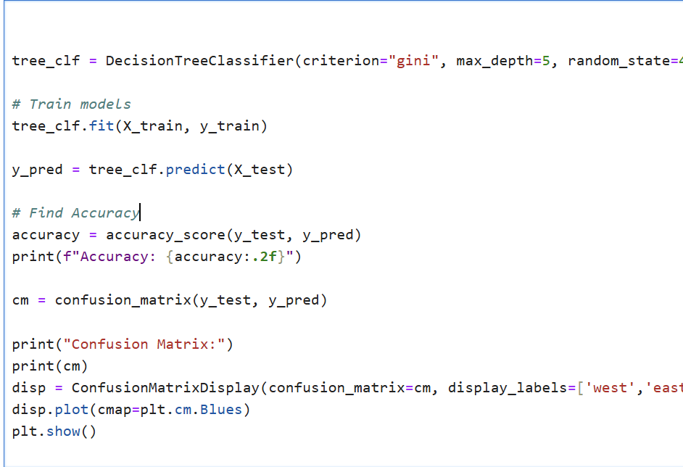
Some attempts，Orientation

